Slide 1

Prediction of FOREX rates using a Hybrid System
Nathan D’Lima
Under the Guidance of
Prof. Shamsuddin S. Khan
Date
Computer Department,
St. Francis Institute of Technology

Slide 2
CONTENTS
Introduction
Problem Statement
Literature survey
Proposed work
Result Analysis
Conclusion
References

Slide 3
Introduction
Currency exchange is the trading of one currency against another.
Home currency – currency to convert
Foreign currency – currency to which home currency is converted
Purchase of goods via the internet where the amount to be paid may be in a foreign currency.
Major uses of Foreign Currency:
  Business trading
  Import and Export of goods
  Private trading
  Banking
  Investments

Slide 4
Introduction
Foreign currency exchange or FOReign EXchange is called FOREX
It is a global decentralized market for the trading of currencies.
The foreign exchange market determines the relative values of different currencies.
The foreign exchange market is unique because of the following characteristics:
  Its huge trading volume
  Its geographical dispersion;
  Its continuous operation: 24 hours a day except weekends
  The variety of factors that affect exchange rates;
  The low margins of relative profit compared with other markets of fixed income

Slide 5
PROBLEM STATEMENT
The main drawback of current systems is the inability to provide high accuracy rates for future predicted values. A simple neural network gives very low accuracy. The objective is to predict future exchange rates using a Hybrid System that combines a Artificial Neural Network to predict the rise or fall of the market and an ANFIS model to predict the future rate with greater accuracy.

Slide 6
LITERATURE SURVEY
Reference | Currencies | Training sample
Emad F, M.A. Montazeri [1] | EURUSD USDCHF | From 1st April 2005 to10th December 2012
A. Cwiok, M. Kordos [2] | (Stock Trading) | From 1st January 1995 to 31st December 2004
B. Christina, Y. Masoud [3] | USDGBP USDEUR USDCHF | From 3rd January 2012 to 1st March 2013
V. Kodogiannis and A. Lolis [5] | USDGBP | From end of 1997 to end of March 2000
A.N. Kia, M. Fathian and M.R. Gholamian [6] | EURUSD | From 1st August 2001 to 31st July 2010

Slide 7
LITERATURE SURVEY
Reference | Method | Performance
Emad F, M.A. Montazeri [1] | FLIT2FNS - IT2 fuzzy system without clustering combined with FLANN neural network T1FCMFNS - Type-1 implementation of created system IT2FCMFNS - IT2 FCM based IT2 Neuro-Fuzzy System |  |  | EURUSD |  | USDCHF
 |  | FLIT2FNS |  | 0.00613 |  | 0.00582
 |  | T1FCMFNS |  | 0.00172 |  | 0.00207
 |  | IT2FCMFNS |  | 0.00165 |  | 0.00101
A. Cwiok, M. Kordos [2] | Standard BP with momentum Modified BP Variable Step Search | Provides optimal buy and sell signals
B. Christina, Y. Masoud [3] | Neural Network VSSA RSSA | Basic RSSA – 60% accuracy Neural Network – 48% accuracy (SSA 67% better than NN)
V. Kodogiannis and A. Lolis [5] | MLP with BP RBF ARNN Elman NN AFLS |  | %Error |  | RMSE
 |  | MLP | 0.31 |  | 0.421
 |  | RBF | 0.2646 |  | 0.3905
 |  | ARNN | 0.2711 |  | 0.4021
 |  | Elman | 0.2683 |  | 0.4010
 |  | AFLS | 0.2514 |  | 0.3939
A.N. Kia, M. Fathian and M.R. Gholamian [6] | Single ARIMA Single MLP Single RBF Hybrid (ARIMA+MLP+RBF) |  | RMSE |  | D-stat
 |  | ARIMA | 0.0081 |  | 65%
 |  | MLP | 0.0076 |  | 67%
 |  | RBF | 0.0085 |  | 59%
 |  | Hybrid | 0.0068 |  | 71%

Slide 8
PROPOSED WORK
Propose a new technique which uses an Artificial Neural Network and with back propagation and a Hybrid Neuro-Fuzzy System.
Apply methods used in stock market prediction to predict rise and fall of FOREX rates.
A ANN with standard back propagation algorithm to determine trend of the market.
It takes 4 inputs and gives the trend of the market as output.
Dataset
  From: http://www.oanda.com/currency /historical-rates/
  Records from 1st November 1993 till date

Slide 9
PROPOSED ANN ARCHITECTURE
SMA
ROC
Rise / Fall of FOREX market
STO
Predicted Output
ATR
Feedforward
Update Weights
Feedback
Error
Actual Output
─
Figure 1: MLP Network with Back Propagation

Slide 10
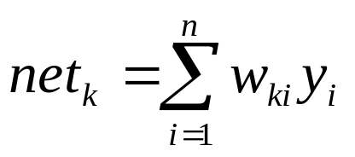
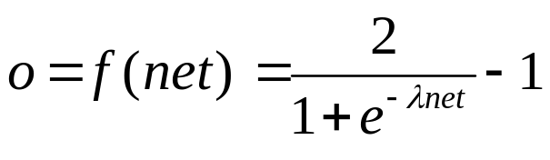
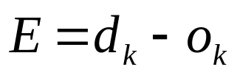
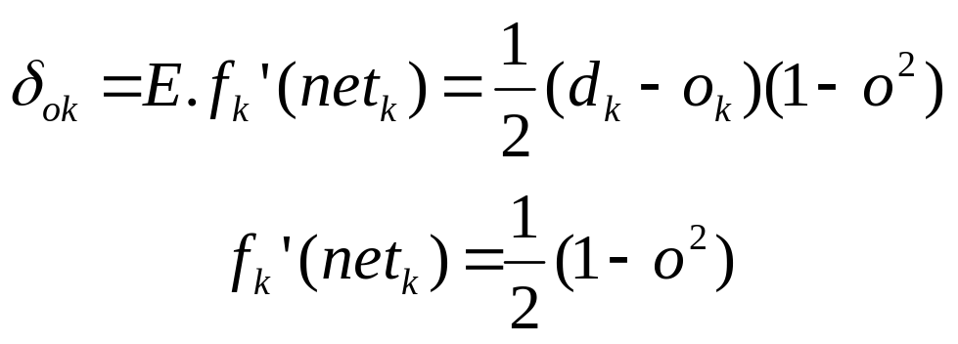
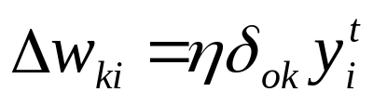
Required Formulae ^{[7]}
For input data set y and weights w –
Value of net at each node k :
Activation function at each node :
Error at output :
Weight update :
(4)
(5)
(6)
(7)
(8)
(9)

Slide 11
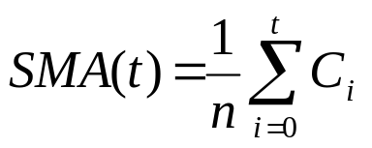
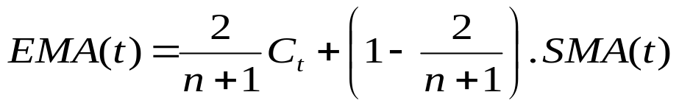
Inputs and Output
Inputs:
  Closing price : The closing price for USD v INR is taken.
  ROC: Rate of Change for the past 14 days given by-
  SMA : Simple Moving Average of the past 14 days given by –
  EMA : Exponential Moving Average given by –
No of hidden neurons :
  Based on experiments conducted (as shown in Figure 2), 5 hidden neurons are required with Learning rate 0.1 and Momentum 0.25
Outputs:
  Trend of the FOREX Market.
(1)
(C_{i} is the closing Price)
(2)
(3)

Slide 12
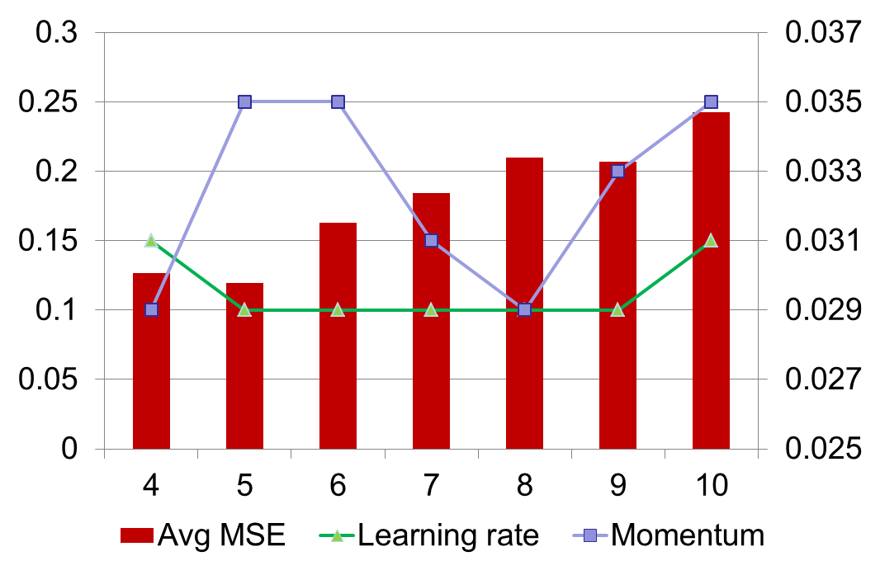
Determination of Number of Hidden Neurons
Figure 2: Determination of Number of Hidden Neurons based on Learning rate and Momentum

Slide 13
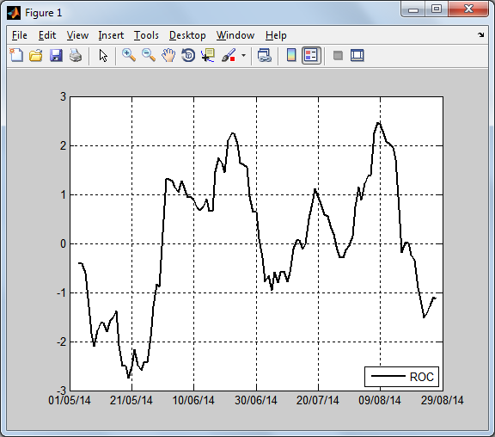
Rate of Change
Figure 3: Rate of Change

Slide 14
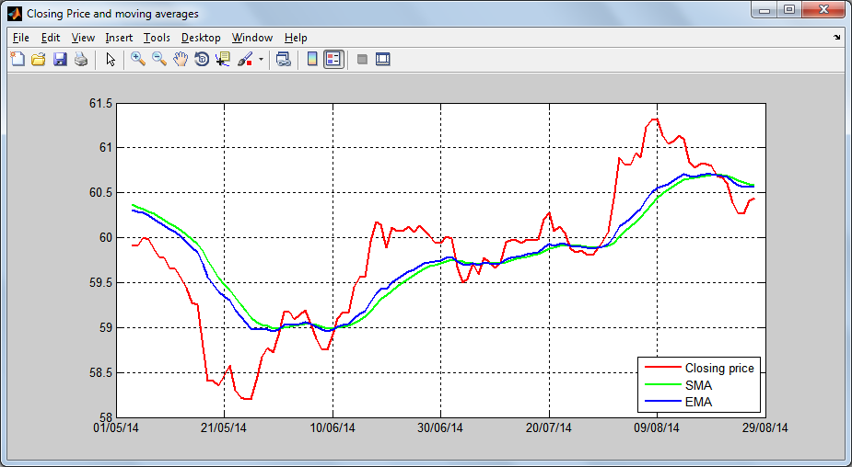
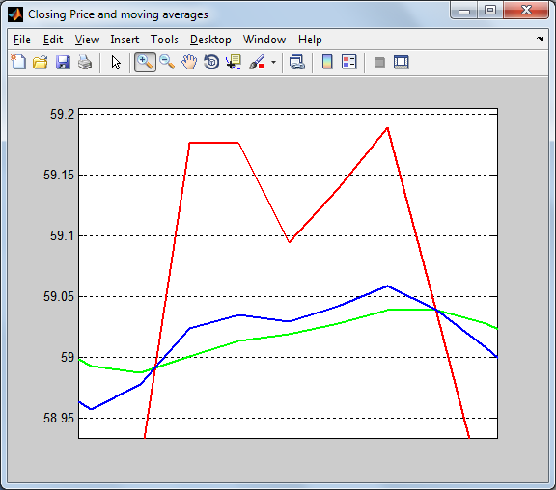
Closing Price and Moving Averages
Figure 4: Closing Price, SMA and EMA

Slide 15
PROPOSED WORK
The first method uses a ANN to predict the market trend.
The second method uses a hybrid neuro-fuzzy system to predict the FOREX rate accurately.
For this, ANFIS model is used.
It takes 2 inputs and gives the predicted exchange rate as output.

Slide 16




ANFIS ARCHITECTURE
A₁
Closing Rate
W₁
π
N
f₁
A₂
Predicted FOREX rate
Σ
B₁
Moving Average
π
N
f₂
W₂
B₂
Input Layer
Layer 1
Fuzzfication
Layer 2
Firing strength
Layer 3
Normalization
Layer 4
Finding consequent
Layer 5
Defuzzification and Output
Figure 5: ANFIS architecture [8]

Slide 17
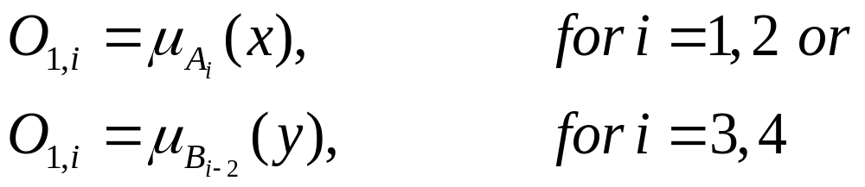
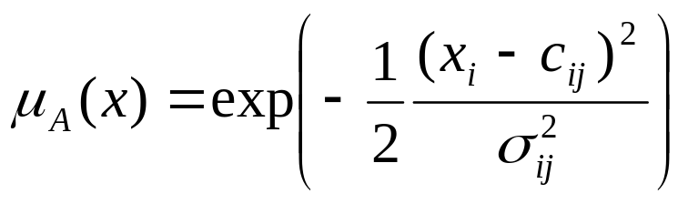
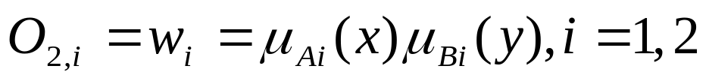
Required Formulae ^{[8]}
Layer 1 : Each node is an adaptive node with a node function –
Layer 2 : Each node is an fixed node labelled Π with output as product of all incoming signals –
(10)
(11)
(12)

Slide 18
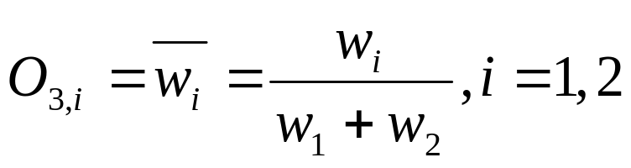
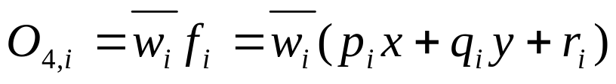
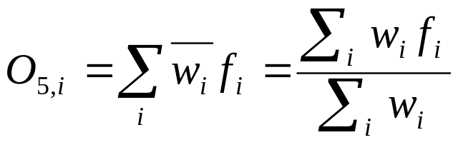
Required Formulae ^{[8]}
Layer 3 : Each node is an fixed node labelled N with i^{th} node calculating the normalized firing strength –
Layer 4 : Every node in this layer is a fixed node labelled Σ, which computes the firing strength of the consequent parameters –
Layer 5 : It has a single fixed node labelled Σ, which computes the overall output as summation of incoming signals –
(13)
(14)
(15)

Slide 19
Inputs and Output
Inputs:
  Closing Price : The closing price for USD v INR is taken.
  Moving Average : Simple Moving Average is used.
No of Membership Functions
  Based on a set of experiments, 5 membership functions are required for each input as shown in Figure 6, 7 and 8.
Output:
  Predicted FOREX Rate.

Slide 20
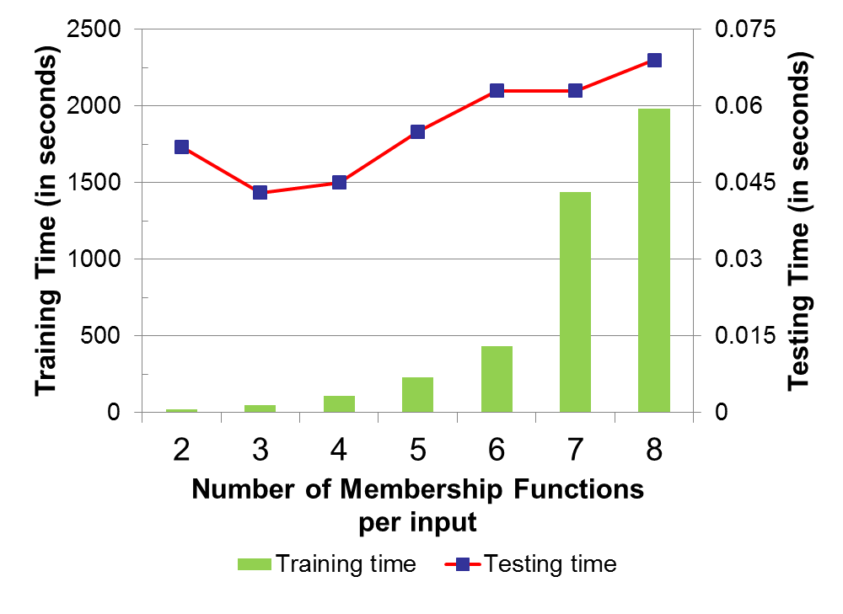
Training and Testing time
No of MF | Training time | Testing time
2 | 19.544 | 0.052
3 | 48.508 | 0.043
4 | 106.512 | 0.045
5 | 230.834 | 0.055
6 | 432.546 | 0.063
7 | 1436.395 | 0.063
8 | 1982.937 | 0.069
Figure 6: Training and Testing time for different membership functions

Slide 21
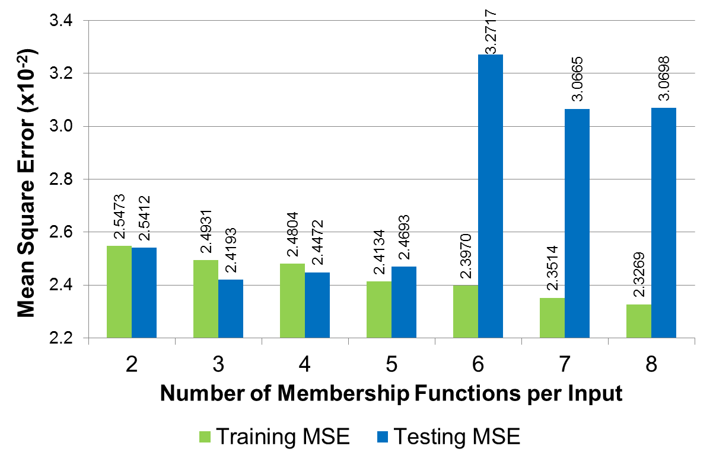
Mean Square Error
Figure 7: Mean Square Error (MSE) for Training and Testing using different membership functions

Slide 22
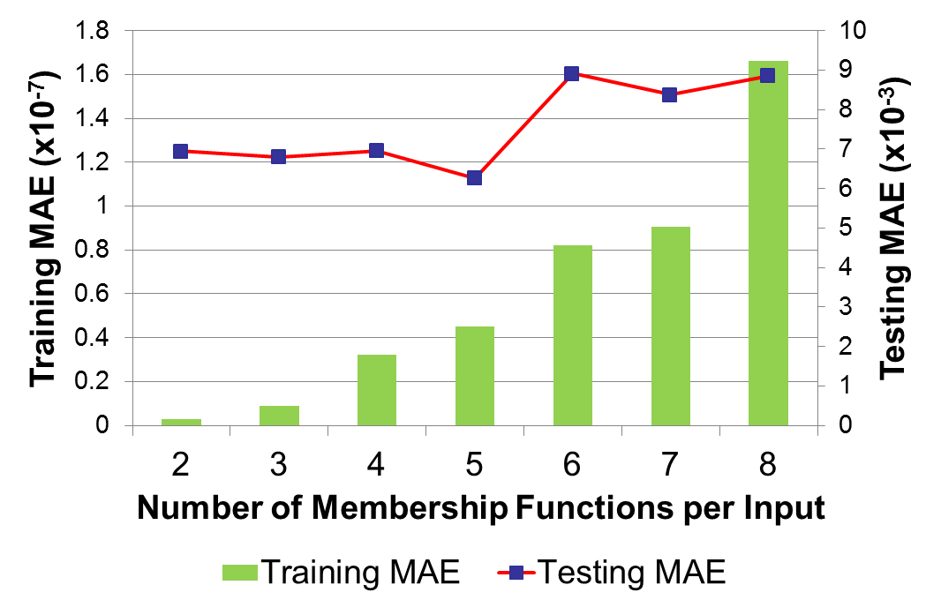
Mean Absolute Error
No of MF | Training MAE | Testing MAE
2 | 2.77E-09 | 6.94E-03
3 | 8.90E-09 | 6.80E-03
4 | 3.23E-08 | 6.96E-03
5 | 4.52E-08 | 6.27E-03
6 | 8.23E-08 | 8.92E-03
7 | 9.04E-08 | 8.37E-03
8 | 1.66E-07 | 8.85E-03
Figure 8: Mean Absolute Error (MAE) for Training and Testing using different membership functions

Slide 23

Result Analysis

Slide 24
Conclusion
Forex prediction minimizes risks and maximized profits.
Prediction allows traders to use various strategies and trade various currencies to obtain maximum profit.
Hybrid Systems perform better than individual systems like NN, ARNN, RBF, etc.
Combination of ANN (to check trend of market) and Hybrid Neuro-Fuzzy System (to predict the rate) provides a more robust and accurate system.

Slide 25
REFERENCES
[1] Emad F, M.A. Montazeri, “ Forecasting Foreign Exchange Rates Using an IT2 FCM based IT2 Neuro-Fuzzy System” in 21st Iranian Conference on Electrical Engineering (ICEE), 2013.
[2] A. Cwiok, M. Kordos, “A New Approach to Neural Network Based Stock Trading Strategy”, in Intelligent Data Engineering and Automated Learning - IDEAL 2011Lecture Notes in Computer Science Volume 6936, 2011, pp 429-436.
[3] B. Christina, Y. Masoud, “FORECASTING EXCHANGE RATES: AN OPTIMAL APPROACH” in J Syst Sci Complex (2014) 27: 21–28.
[4] http://fxtrade.oanda.com/learn/technical-analysis-for-traders/ stochastic/summary

Slide 26
REFERENCES
[5] V. Kodogiannis and A. Lolis, "Prediction of foreign exchange rates by neural network and fuzzy system based techniques," in European Symposium on Artificial Neural Networks Bruges (Belgium), April 2001, pp. 245-250
[6] A.N. Kia, M. Fathian and M.R. Gholamian, “Using MLP and RBF Neural Networks to Improve the Prediction of Exchange Rate Time Series with ARIMA”, International Journal of Information and Electronics Engineering, Vol. 2, No. 4, 2012, pp. 543-546
[7] Jacek M. Zurada, Introduction to Artificial Neural Systems, West Publishing Company, 1999.
[8] J.S.R. Jang, C.T. Sun and E. Mizutani, Neuro-Fuzzy and Soft Computing – A Computational Approach to Learning and Machine Intelligence, Prentice-Hall Inc., 1997.

Slide 27
QUESTIONS?

Slide 28
THANK YOU!

